Slide 1
Computational Text Analysis for Content Analysis
By Vaishali Kushwaha, Yana Mommadova, Margarida Rodrigues, and Yunus Emre Tapan
Digital Integration Teaching Initiative (DITI)
For ENGL 1400: Intro to Literary Studies
Mary Loeffelholz
Fall 2022
Feel free to ask questions at any point during the presentation!
Notes:
Hello Everyone! Welcome to the ‘computation text analysis’ module - developed and presented by the Digital Integration Teaching Initiative (DITI).
I am Vaishali, a DITI Fellow and a PhD Candidate at the School of Public Policy and Urban Affairs
I am here with my colleague….
Together we will introduce you to some easy and interesting tools for context analysis!

Slide 2
Workshop Agenda
Introduction to definitions and key terms in computational text analysis (What)
Discussion on its applications and uses in research (Why)
Demonstration of web-based text analysis tools (How)
Word Counter, Word Trees, Voyant, Lexos
Slides, handouts, and data available at: https://bit.ly/3p6KEeU
Notes:
During this session we will share ‘What’ is computational analysis. Few key terms and definitions.
We will briefly discuss its significance and ‘Why’ it might be relevant for you to learn this method.
We will then dive deeper into ‘How’ some of the web-based tools that can be used for text analysis.
We will be introducing two exploratory tools - namely - Word Counter and Word Trees
- and - two more comprehensive tools - Voyant and Lexos.

Slide 3
What is Computational Text Analysis?
Notes:
Does anyone know what is ‘Computation Text Analysis’?
Has anyone used it before or come across articles where it has been used?
Would someone like to share?
TIME LAPSE: 5-10 mins

Slide 4
Computational Text Analysis
Text analysis is a process to make inferences based on textual data. Computational text analysis refers to the array of methods used to “read” texts with a computer. It is similar to statistical analysis, but the data are texts (words) instead of numbers.
Text analysis:
Involves a computer drawing out patterns in a text, and a researcher interpreting those patterns.
Includes methods such as word count frequency, nGrams, and sentiment analysis.
Conducted using web-based tools or coding languages like Python and R
Notes:
Computational text analysis refers to an array of methods that can be used to “read” texts with a computer.
Text analysis is often used on a corpus, or a collection of multiple texts, and provides a glimpse into patterns across the texts.
This form of analysis can range from basic word frequency counts to more advanced techniques like machine learning.
Computational text analysis can be conducted using web-based tools or coding languages like Python and R.
Many web-based tools are open-access and usually free to use. These tools DO have limits on how much data they can handle but are usually useful for small projects.

Slide 5
Why Computational Text Analysis?
Computational text analysis can help us analyze very large amounts of data, identify keywords, and discover patterns in a corpus of text(s). Using text analysis, researchers may find surprising results that they would not have discovered from close reading or traditional methods alone.
From collections of texts, researchers can discover formal continuities or discontinuities in literary genres, or textual similarities across genres. For example, computational tools reveal textual similarities between detective fiction and science fiction over long periods of time.
Notes:
https://core.ac.uk/download/pdf/158313275.pdf

Slide 6
Key Terms
Corpus (plural–corpora): A collection of texts used for analysis and research purposes.
Stop words: Words that appear frequently in a language, like pronouns, prepositions, and basic verbs. These are often removed for computational analysis. Some English stop words include: a, the, she, he, I, me, us, of, is, would, could, should, etc.
Word Count Frequency: Counting the total times a word appears in a text/corpus or the percentage of how often it appears.
nGram: A continuous sequence of n items in a text. A bigram (or 2 continuous words) could be ‘United States,’ while a trigram (3 words) could be ‘yes we can.’
Sentiment Analysis: Measuring the sentiment of a text based on a scale such as negative/positive or happy/sad. Each word has a particular weight to determine where on the scale it falls, and these weights are calculated to determine a text’s overall sentiment.
Notes:
Corpus (plural–corpora): A collection of texts used for analysis and research purposes.
Stop words: Words that appear frequently in a language, like pronouns, prepositions, and basic verbs. These are often removed for computational analysis. Some English stop words include: a, the, she, he, I, me, us, of, is, would, could, should, etc.
Word Count Frequency: Counting the total times a word appears in a text/corpus or the percentage of how often it appears.
nGram: A continuous sequence of n items in a text. A bigram (or 2 continuous words) could be ‘United States,’ while a trigram (3 words) could be ‘yes we can.’
Sentiment Analysis: Measuring the sentiment of a text based on a scale such as negative/positive or happy/sad. Each word has a particular weight to determine where on the scale it falls, and these weights are calculated to determine a text’s overall sentiment.

Slide 7
Examples from Practice
Notes:
Has someone read a research or newspaper article that has used text analysis ?
Would someone like to share?

Slide 8
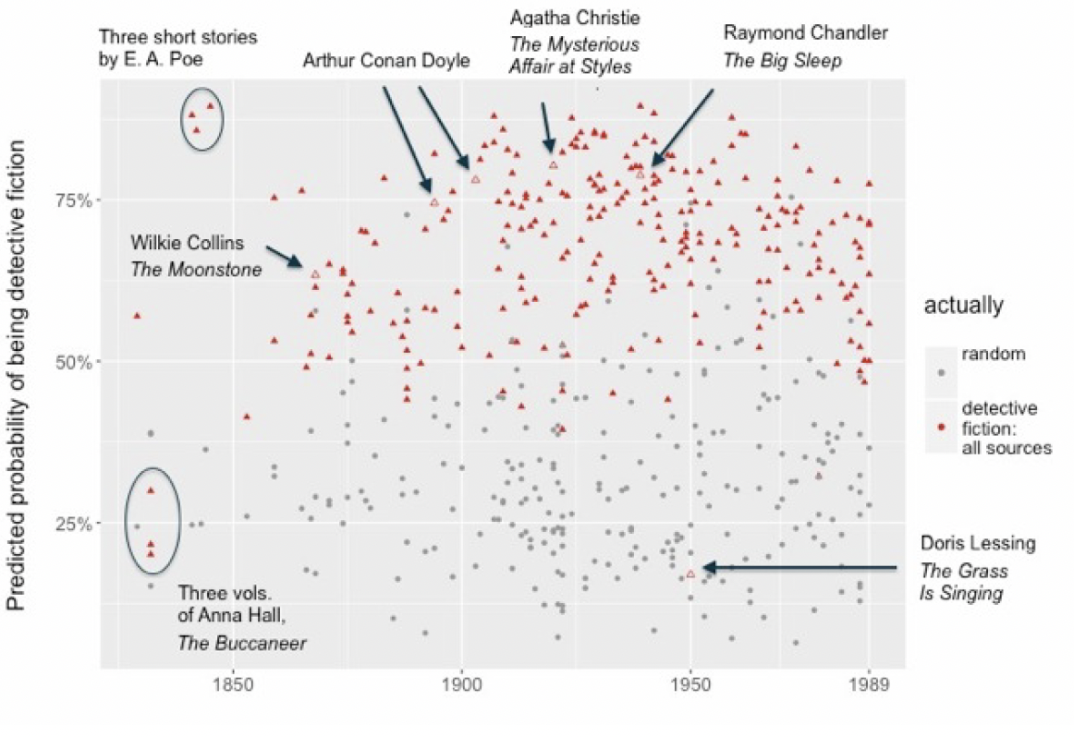
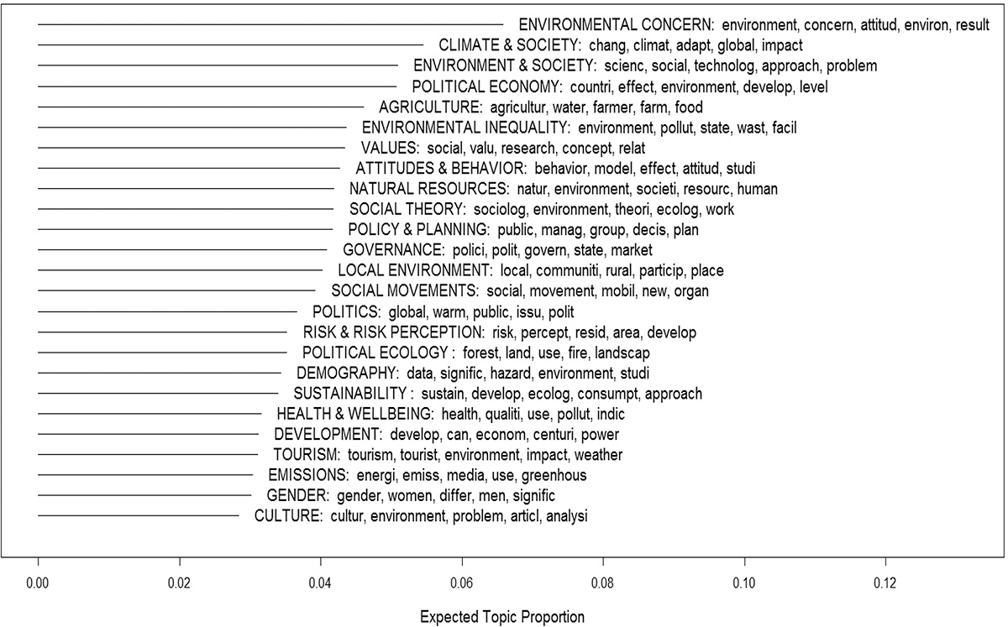
Key Topics in Critical Literature Studies
Predicted probabilities of coming from the “detective fiction”
25 topics ranked from most to least prevalent in the corpus of 815 environmental sociology articles, including the top five associated word stems. The x-axis represents the proportion of each topic within the overall corpus.
Jeremiah Bohr & Riley E. Dunlap (2018) Key Topics in environmental sociology, 1990–2014: results from a computational text analysis, Environmental Sociology, 4:2, 181-195, DOI: 10.1080/23251042.2017.1393863
Notes:
This is a journal article titled “The Life Cycle of Genres”, by Tes Underwood.

Slide 9
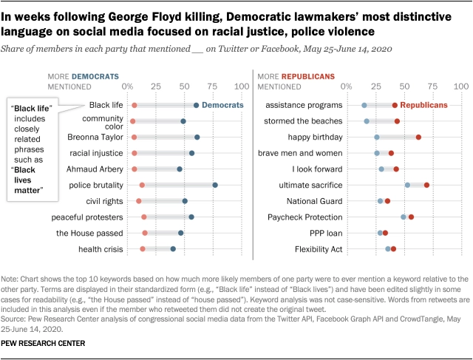
Content warning: police violence, racism
Posts mentioning ‘Black lives matter’ spiked on lawmakers’ social media accounts after the death of George Floyd
Pew Research Center July 16, 2020 article
Methodology
Notes:
This article by the Pew Research Center claims that “Social media posts from members of Congress referencing “Black lives matter” increased dramatically in the weeks following the death of George Floyd. There were more total mentions of the phrase “Black lives matter” and the #BlackLivesMatter hashtag from members of the 116th Congress on Twitter and Facebook between May 25 and June 14, 2020, than from all members of Congress in the five years prior.
I am aware that the content of this article may be disturbing, however I am still sharing it with you because this is a research based piece which also outlines the entire methodology they used - from data collection, processing, analysis to results.
This article will be helpful for students who are interested in analyzing the content on social media.
Let us briefly look at one of the outcomes from this research - shown in the slide here.

Slide 10
Text Preparation
Notes:
Now let's get down to the nitty-gritty of computational text analysis and see how to prepare and analyze textual data.
Today, we will show an example of applying computational text analysis, but to a topic more closer to this class! We will work with the two manifestos that were the reading assignment for a writing class!

Slide 11
Corpus Building
Questions to consider as you begin your research:
What are my research questions and why am I creating a corpus?
What am I asking my corpus to do?
What text(s) should form my corpus to answer my research questions?
How should I organize my corpus to streamline my research processes and save time?
Notes:
Corpus building is an important aspect of qualitative research and content analysis.
Your data collection should be driven by your research questions.
Some of the key questions that you to consider at the beginning are:
What are my research questions and why am I creating a corpus?
What am I asking my corpus to do?
What text(s) should form my corpus to answer my research questions?
How should I organize my corpus to streamline my research processes and save time?

Slide 12
Preparing Your Text
Choose the texts or text selections that you would like to include.
Create a folder on your computer or cloud storage where you will store your corpus. Give it a clearly descriptive name, without spaces or special characters.
Copy and paste the text into a plain text editor (on Macs: Text Edit; on Windows: Notepad)
Mac users, you may need to make your Text Edit into a ‘plain text’. Open Text Edit, go to Preferences, and make sure “plain text” is selected
Save the text as a plain text file (with a .txt extension). Always make sure to name your files so you know what is in them!
Repeat steps above for each text in the corpus.
Notes:
Teaching note: this is what students would be doing if they were preparing their text; but here, we are providing them with the prepared text.
Text preparation is a easy step, but it can be repetitive if you are working with multiple files and building a corpus.
First, Choose the texts or text selections that you would like to include.
Create a folder on your computer or cloud storage where you will store your corpus. Give it a clearly descriptive name, without spaces or special characters.
Copy and paste the text into a plain text editor (on Macs: Text Edit; on Windows: Notepad)
Mac users, you may need to make your Text Edit into a ‘plain text’. Open Text Edit, go to Preferences, and make sure “plain text” is selected
Save the text as a plain text file (with a .txt extension). Always make sure to name your files so you know what is in them!
Repeat steps above for each text in the corpus.

Slide 13
Our Corpus: source files
For our corpus, we will work with the following texts:
Frederick Douglass, Narrative of the Life of Frederick Douglass, an American Slave
Benjamin Franklin, Autobiography of Benjamin Franklin
Harriet Jacobs, Incidents in the Life of a Slave Girl
Jonathan Edwards, Personal Narrative
Herman Melville, The Piazza Tales

Slide 14
Sample Corpus
The following .txt files are available on:
https://bit.ly/3d79hpb
Notes:
We have created the sample corpus for this class, which you can use to explore the tools
Corpus can be downloaded from the GitHub link shared in the syllabus or the link on the slide

Slide 15
Exploratory Tool:
Word Counter
Notes:
Let’s begin analyzing the sample text using two basic exploratory tools
Once again, I recommend that you first look at the slides and then follow Adam and try out the tool during the demonstration

Slide 16
Word Counter
https://databasic.io/en/wordcounter/
A user-friendly basic word counting tool
It allows you to count words, bigrams, and trigrams in plain text files and to download spreadsheets with your results
The max file upload is 10MB
The default is to lowercase all words and apply stopwords
It can be run with and without stopwords
Notes:
Let’s first look at Word Counter, a basic exploratory tool that analyzes your text and tells you the most common words and phrases.
Word Counter helps count the words, bigrams and trigrams in plain text.
It uses only .txt files or text that is copied and pasted.
The maximum file size that you can upload is 10MB and the results can be download in spreadsheet format.
By default, the WordCounter will lowercase all the words in your input file, and will also apply a stop words list.
Because this is a very basic tool, it does not allow you to edit the stop words but You can turn these options on and off.
DEMONSTRATE

Slide 17
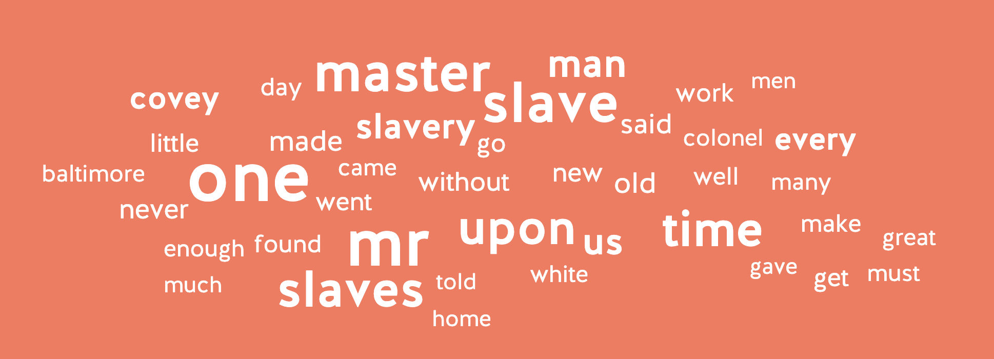
Word Counter Examples
This is a word cloud. It is helpful to get a sense of the most used words in a document. Words used more often are bigger, and ones used less often are smaller.
Word cloud from Narrative of the Life of Frederick Douglass, by F. Douglass
Notes:
This is the result or output of Word Counter for ‘A Hacker’s Manifesto’.
It shows the most used words in a document.
Words used more often are bigger, and ones used less often are smaller.

Slide 18
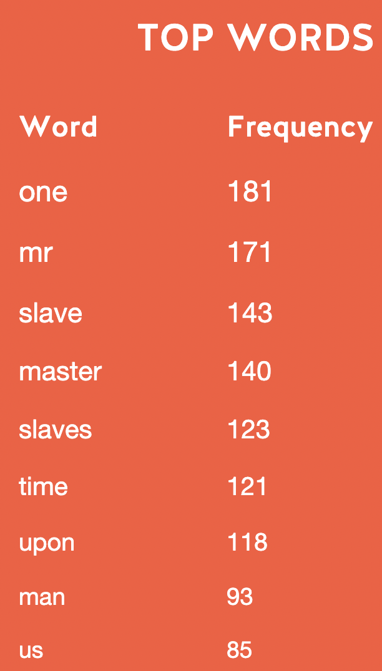
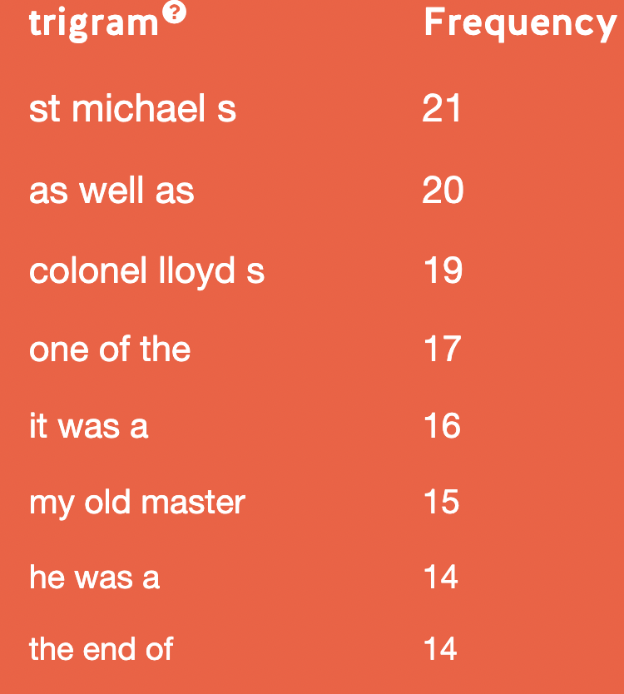
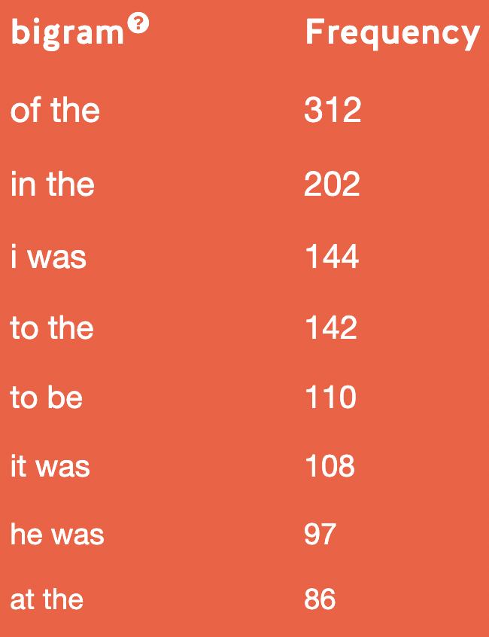
Word Counter Examples
Stopwords aren't removed for the bigrams and trigrams because they need context.
The top trigram is St. Michael’s, a town in Talbout County, Maryland, the location of Colonel Lloyd's plantation, where Douglass was enslaved. Note that Colonel Lloyd's is also a top trigram.
Shows the top words in the text.
Notes:
It’s interesting to note in the trigram that st. michael’s and colonel lloyd’s are taken as 3 words, as the s is taken as a word.
These are the results for ‘Top Word’, Bigrams and Trigrams.
The word cloud provided us the visual aspect while the list of top word shows the frequency as well.
If you look at the results here, the most frequent word in is Narrative of the Life of Frederick Douglas is ‘one’, followed by ‘mr.’, ‘slave’ and ‘master’.
Stopwords are not removed from the bigrams and trigrams, to provide context

Slide 19
Exploratory Tool:
Word Trees
Notes:
The second basic exploratory tool that we are showing you is called Word Trees

Slide 20
Word Trees
https://www.jasondavies.com/wordtree/
A word tree depicts multiple parallel sequences of words
This is a good way to see patterns in word usage, based on words that appear before and after a term or terms of interest.
There are some restrictions in size: fewer than 1 million words should work
Notes:
The sole purpose of this exploratory tool is to find contextual patterns of a particular word in a particular text.
A typical word tree depicts multiple parallel sequences of words, which is a good way to see patterns in word usage, based on words that appear before and after a term of interest.
The Word tree tool works by copying and pasting the text in the input box
Fewer than 1 million words should work fine!

Slide 21
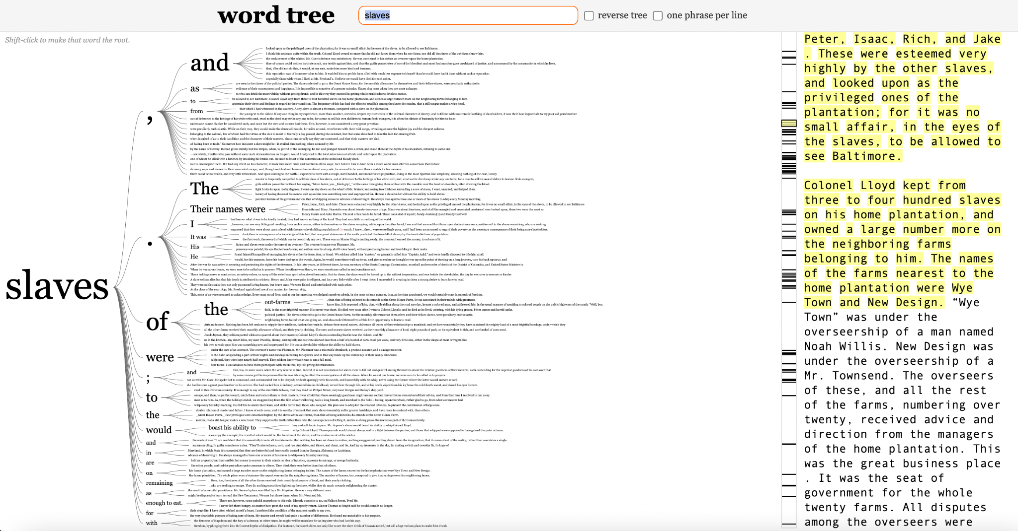
Word Tree Example
Reflects descriptive language on the daily lives of enslaved people.
Notes:
The Word Tree result here is for the word “Class”
We can see how Hacker’s Manifesto mentions the term ‘class’. Class interest, class struggle, class domination are some interesting phrases that provide insight on the manifesto.
Notice that the word seems to be often at the end of a sentence, followed by period.
This is great example where a ‘reverse tree’ would be helpful

Slide 22
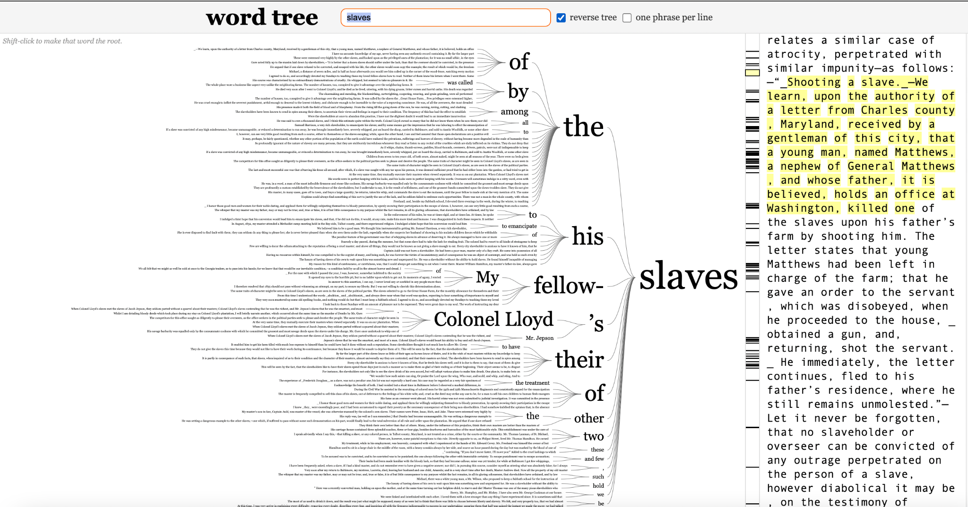
Word Tree: Reverse Trees
It is worth reversing the tree to see the words that often precede it. To do this click “reverse tree” next to the search bar.
Here, ‘the’, ‘his’, ‘my fellow’, and ‘their’ are the dominant words preceding the word ‘slaves’.
Notes:
Word Tree provides the option of ‘reversing the tree’ . It is worth doing it to see the words that often precede the word of choice.
To do this click “reverse tree” next to the search bar.
Here he hacker, the vectoralist, ruling, working etc. are some of the terms preceding the word ‘class’.
-------
Now Julianna will show you Word Counter and Word Tree tools.
The link to word counter and Word Tree website is the ‘links and resources’ handout, you can quickly google it, and I will also share it in the chat.

Slide 23
Your Turn!
Use the sample text or texts of your choice and begin practicing web-browser text analysis. Explore Word Counter and Word Trees!
Discussion Prompts
What limitations are you observing? What functionalities do you wish these tools might offer?
Even with these limitations, how can you apply these simple tools in your research and exploration?
Notes:
Use the sample text or texts of your choice and begin practicing web-browser text analysis. Explore Word Counter and Word Tree!
Discussion Prompts
What limitations are you observing? What functionalities do you wish these tools might offer?
Even with these limitations, how can you apply these simple tools in your research and exploration?
TIME LAPSE: 30-35 mins

Slide 24
Voyant
Notes:
we will now learn about Voyant, a more powerful text analysis and visualization tool that can analyze different texts and file types.

Slide 25
Voyant
Voyant makes it possible to perform analyses on one or multiple files in many ways, including word counts, nGrams (n=number of words), word frequency distributions, word trends across documents, and concordances. It also makes nice visualizations!
https://voyant-tools.org/
Notes:
Voyant makes it possible to perform analysis on one or more files in many ways, including word counts, nGrams, word frequency distributions, word trends, etc.
It also makes nice visualizations!

Slide 26
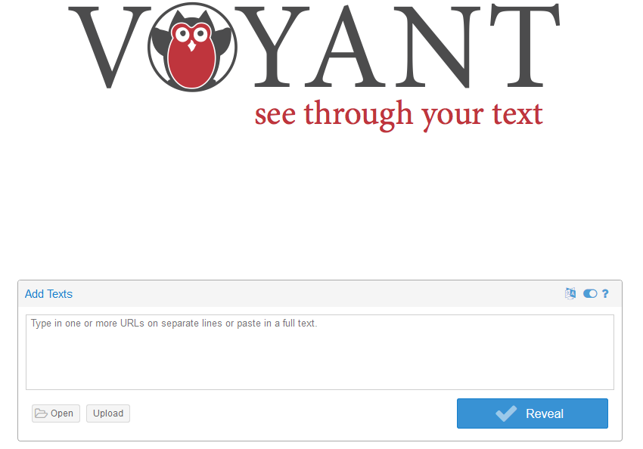
Click on Upload and navigate to the folder with the text document you wish to analyze.
Alternatively, insert URLs or full text into the textbox.
Click here for help and advanced options
Notes:
This is the Voyant homepage and it gives the option to add text via pasting the full text or typing one or more URLs.
Voyant also gives the option of uploading one or more files.
First we will look at the results of single file, the Hacker Manifesto, and then later I will show you results of uploading a corpus, or multiple text files.
Voyant will let you upload larger files than most other interfaces, although it may take more than one try to successfully upload very large files.
Voyant can also read .pdf and .doc formats, but we recommend using .txt files.
Once you have uploaded the file, you can click ‘Reveal’!

Slide 27
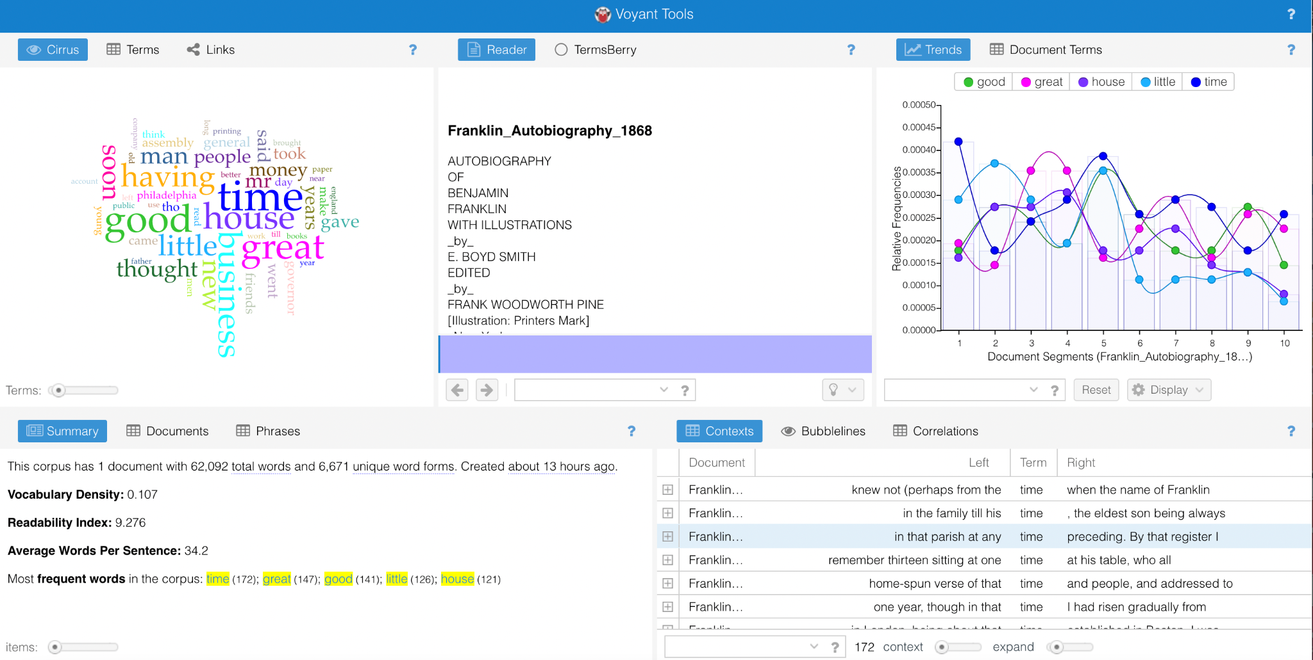
Voyant: Single text Dashboard
Results:
From Benjamin Franklin’s autobiography you can see the default results page with multiple panes:
A word cloud
Reader section
Trends
Document Summary
Word Contexts
These boxes can all be changed!
Benjamin Franklin’s Autobiography
Notes:
And THIS dashboard will be revealed to you!
The dashboard provides several different visualization and ways to analyze a text and also gives interesting information about your corpus or document.
To the left here is the word cloud, it shows the most frequent words in the document, with the stopwords removed and when you hover over a word it shows the actual frequency.
Down here, in the left bottom corner Voyant provides the summary of the basic information about the corpus. Because I used only a single document, it is showing summary of a single document. [Example-Explain]
The reader here, in the middle, provides the text of the document. As you can see it has stop words and punctuations in place because they are important to readers. You can move on individual words and see their document frequency.
On the top right corner, here, is one of my favorite tools - the Trends visualization. It shows the trend of word usage across a given document or across multiple documents of a corpus. [Example-Explain]
At the bottom right corner this tool provides the context of the words or terms. Let’s look closely at this in the next slide!

Slide 28
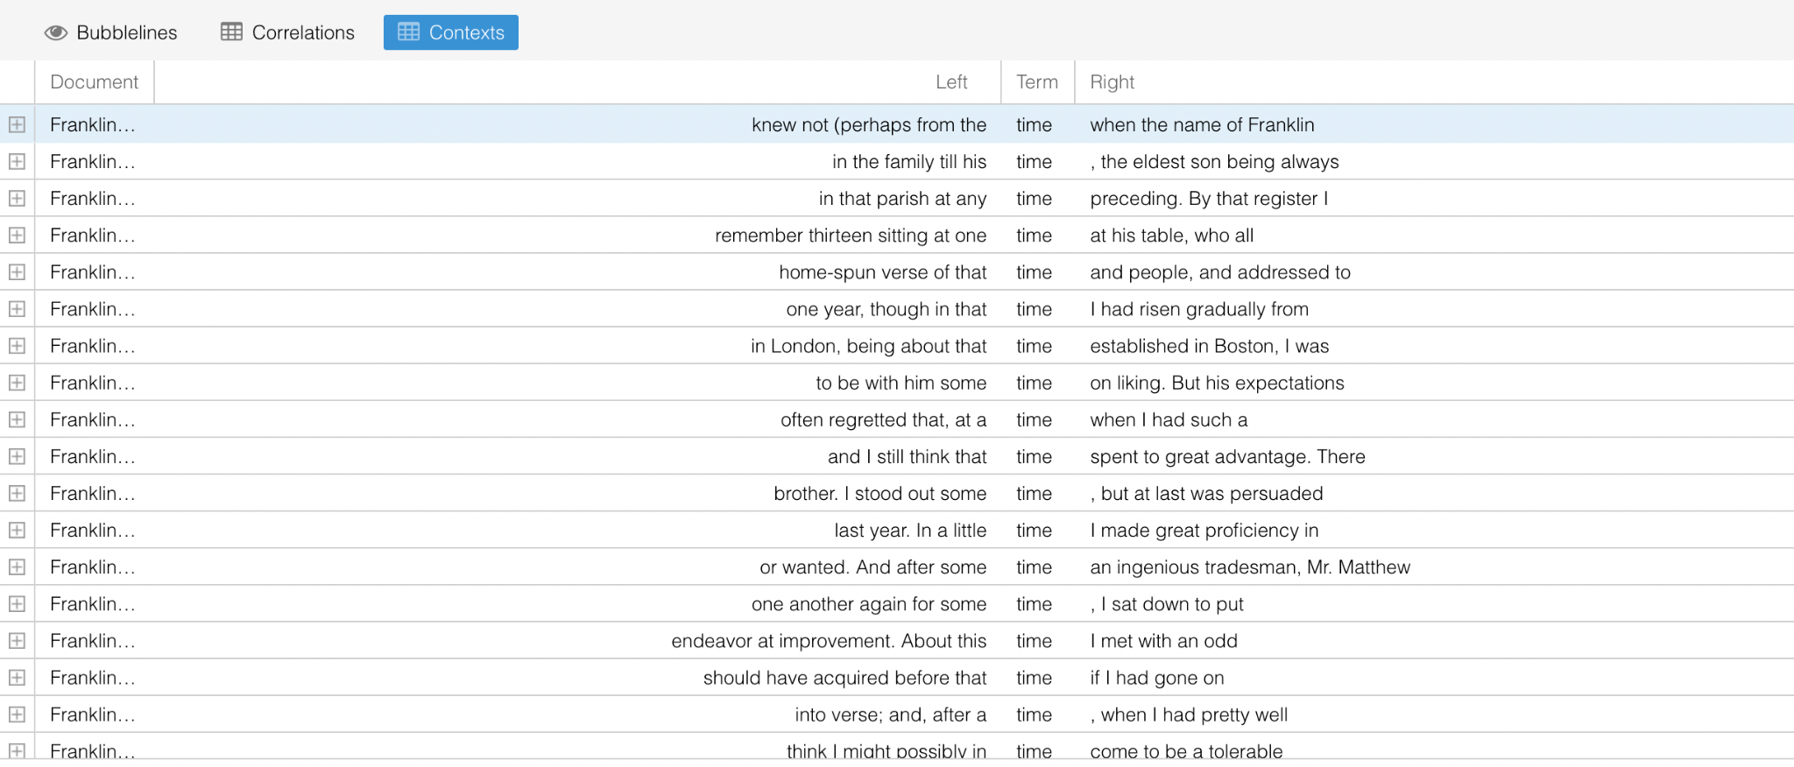
Voyant: Contexts (concordances)
Contexts, or concordances, show the different contexts around particular search terms. For example, you can see all the times the word “time” appears in the text and the contexts in which it appears.
Notes:
Contexts, or concordances, show the different contexts around particular search terms.
For example, you can see all the times the word “class” appears in the text and the contexts in which it appears.

Slide 29
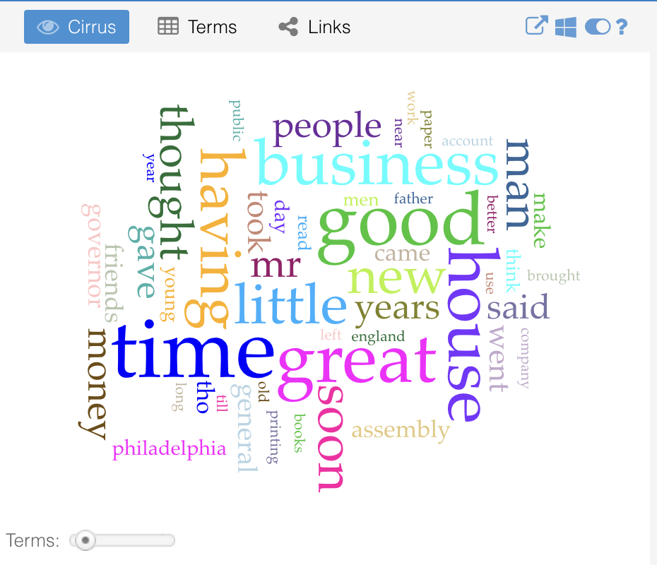
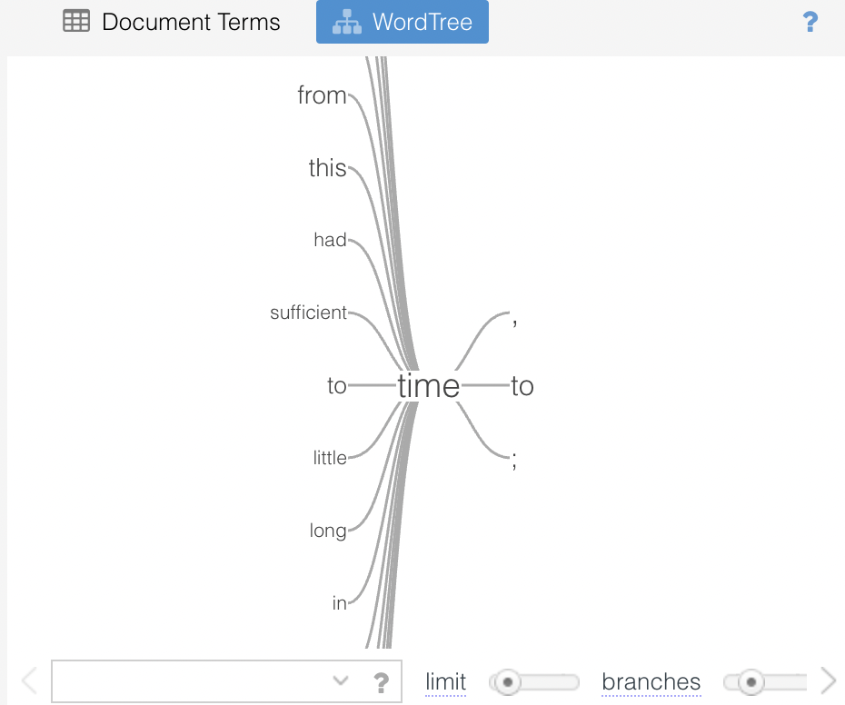
Voyant: Changing displayed results
Hover on the right top corner of a pane and buttons will appear. Select the panes button and choose a new option from the dropdown menu
For our new pane option, we have chosen the WordTree visualization from the ‘visualization tools’ dropdown sub-menu. You can select the number of “branches” by dragging the scroll button at the bottom.
Notes:
Voyant also has a bunch of other tools, which you can find here under the windows image.
Hover on the right top corner of a pane and buttons will appear. Select the panes button and choose a new option from the dropdown menu
For our new pane option, we have chosen the WordTree visualization from the ‘visualization tools’ dropdown sub-menu. You can select the number of “branches” by dragging the scroll button at the bottom. You can also select the word you wish to analyse.
You can find more about the various tools in Voyants documentation page. The ‘? question mark’ is a helpful guide as well
You can also save your results. You can simply go the visualization or result that you are interested in saving and click the ‘export’ button next to the ‘windows’ button.

Slide 30
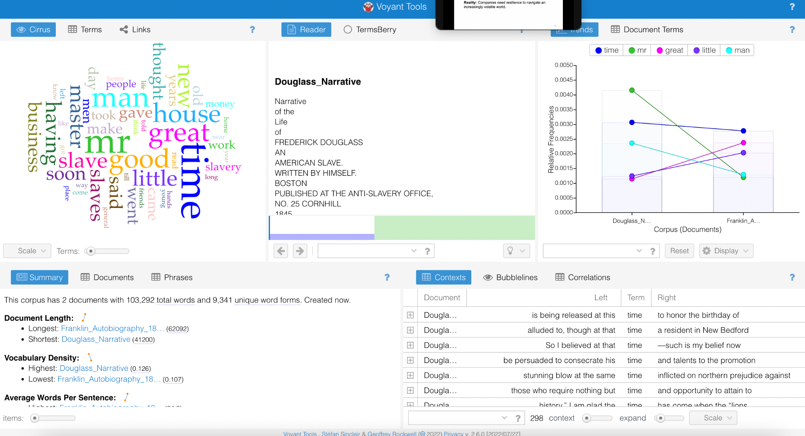
Voyant: Corpus Dashboard
Results page of the corpus.
A word cloud: combining all texts
Reader section: scroll down all texts
Trends: relative frequency of terms across text —good for comparison
Document Summary—good for comparison
Word Contexts: seperate for all texts
Notes:
As mentioned earlier Voyant also allows you to upload a corpus instead of just a single file.
With a corpus or multiple files, Voyant can show trends in word usage across your documents. [Explain]
The word cloud will be for the entire corpus.
The summary will be of all the documents.
And the contexts of a word will be provided across all the documents - just scroll down and check.
-------
Now Julianna will show you the Voyant tool.
As before, the link to voyant website is the ‘links and resources’ handout, you can quickly google it, and I will also share it in the chat.

Slide 31
Your Turn!
Choose a sample text or texts and begin practicing web-browser text analysis. Explore Voyant's features!
Discussion Prompts
What do you find challenging or exciting about this tool?
What interesting or surprising results came up?
How might you interpret those results based on what you know about your field?
Notes:
Use the sample text or texts of your choice and begin practicing web-browser text analysis. Explore Voyant's features!
Discussion Prompts
What do you find challenging or exciting about this tool?
What interesting or surprising results came up?
How might you interpret those results based on what you know about your field?
TIME LAPSE: 40-45 mins

Slide 32
Lexos
Notes:
“CHECK THE TIME and SEE if this section can be delivered”
Option 1: Show slides without Demo
Option 2: Show slides and Demo, but ask students to just see and try later
Our last tool for today is Lexos.
Lexos is a powerful web-based tool to help explore different corpora of digitized texts.

Slide 33
Lexos
Lexos provides a step-by-step guide for text uploading, preparation, and analysis.
Upload: upload your .txt file
Manage: select the files you want to prepare and analyze
Prepare: prepare your text for analysis
Visualize: create visualizations of patterns across your corpus or in single texts
Analyze: analyze your text
http://lexos.wheatoncollege.edu/upload
Notes:
Lexos provides a workflow of effective practices to help you be cognizant of choices you are making.
For Lexos, separate .txt files are required.
Lexos also provides a step-by-step guide for corpus uploading, preparation, and analysis.
When compared to the rest of the tools introduced today, Lexos provides the most freedom and control to users.
For example, you can create visualizations for patterns across your corpus for individual texts. I will show this potential using an example of world cloud.

Slide 34
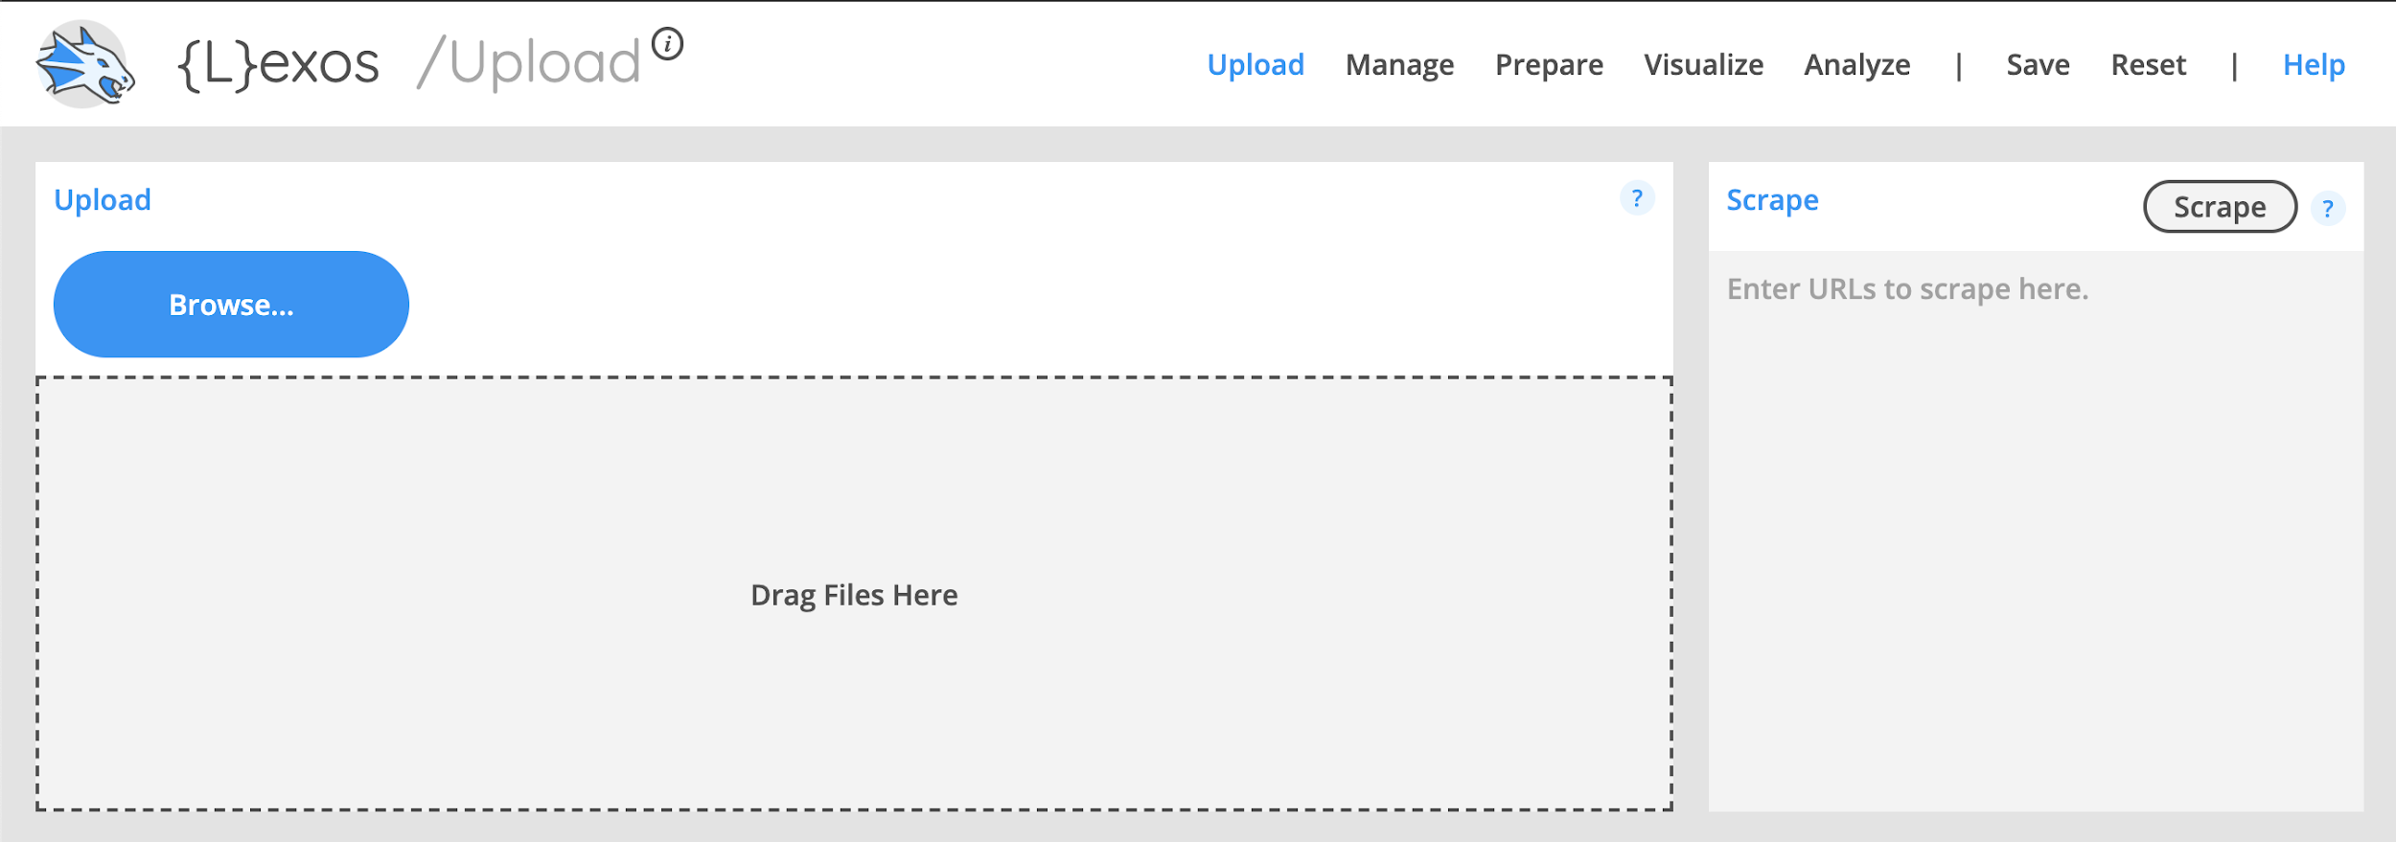
Lexos: Upload
Click Browse and select your entire text (or drag file into the “Drag Files Here” area)
You will not get a super visible notification when the upload is done—click “Manage” to double check that the text file is there.
Notes:
You can upload your corpus (your separate .txt. files), by Clicking “Browse” and selecting your entire corpus
You will not get a super visible notification when the upload is done - click “Manage” to double check that the text file is there.

Slide 35
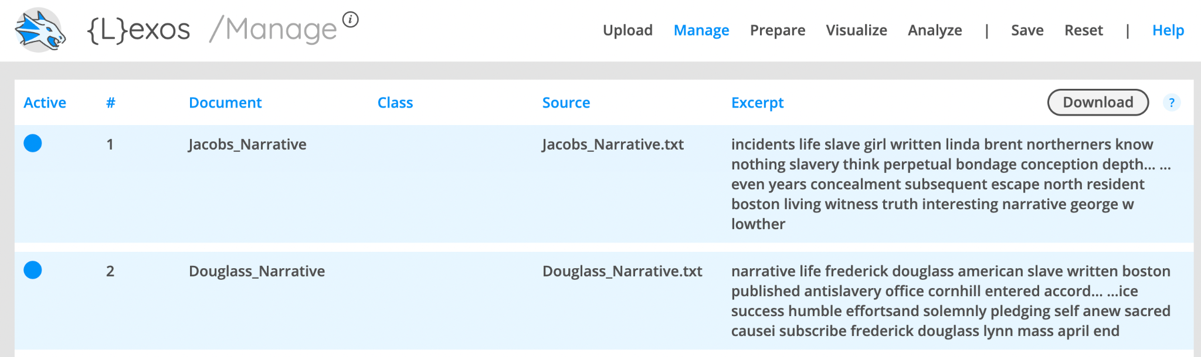
Lexos: Manage
Make sure the document you want to use is selected (blue = selected, gray = not selected)
Notes:
This is the ‘Manage’ Screen
Make sure the document you want to use is selected (blue = selected, gray = not selected)

Slide 36
Lexos: Prepare (scrub)
Lexos demonstrates some more advanced options you have for preparing your corpus. By “scrubbing,” you are transforming the texts in your corpus and making choices that will impact your results. Here are some possibilities:
Make Lowercase: make all your letters lowercase. Even though you know “A” and “a” are the same letter, the computer treats these as two separate characters. Lowercasing removes this distinction.
Remove Punctuation: remove punctuation, which may influence your results.
Stop/Keep Words: remove a list of words. Usually these would be stopwords, or the most common words in a language (English: the, a she, her, it, him, they, etc).
Lemmas: standardize to the stem of word. For example, you can stem all forms of talk: talking, talked, talks, etc. to “talk”
Notes:
Lexos demonstrates some more advanced options you have for preparing your corpus.
By “scrubbing,” you are transforming the texts in your corpus and making choices that will impact your results.
Here are some possibilities:
Make Lowercase: make all your letters lowercase. Even though you know “A” and “a” are the same letter, the computer treats these as two separate characters. Lowercasing removes this distinction.
Remove Punctuation: remove punctuation, which may influence your results.
Stop/Keep Words: remove a list of words. Usually these would be stopwords, or the most common words in a language (English: the, a she, her, it, him, they, etc).
Lemmas: standardize to the stem of word. For example, you can stem all forms of talk: talking, talked, talks, etc. to “talk”

Slide 37
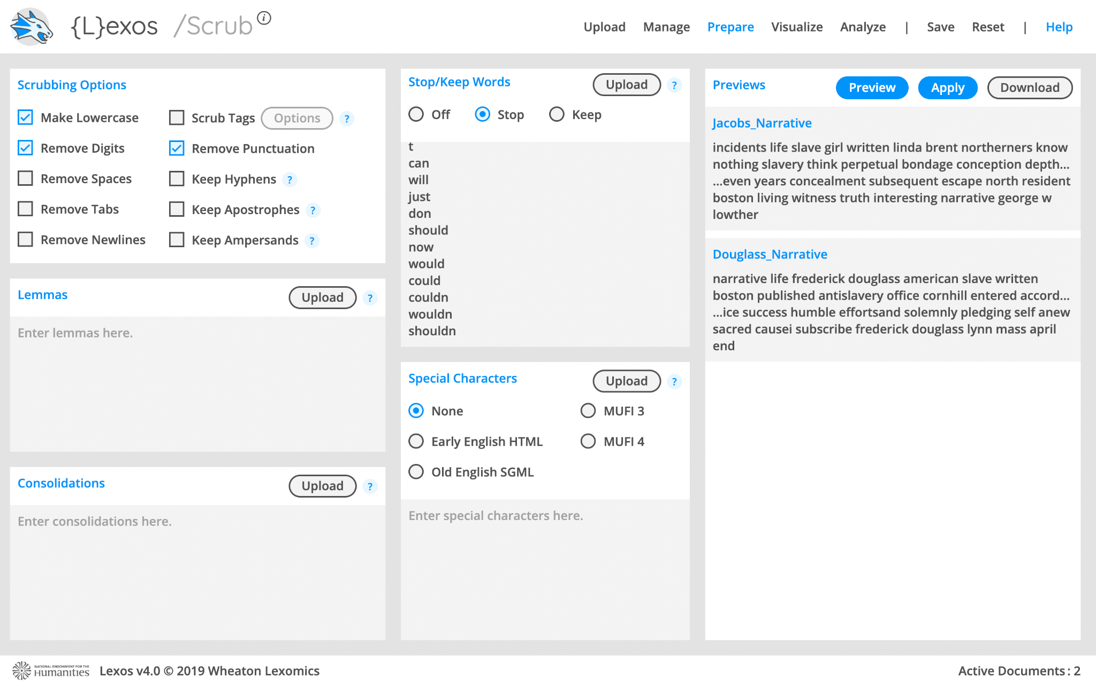
Lexos: Removing Stopwords
Get a list of English stopwords here: https://gist.github.com/sebleier/554280 (there is also a copy on the GitHub page). Copy and paste the stopwords (or upload the .txt file) into the “Stop/Keep Words” box then select “Stop”
Notes:
This is the ‘Prepare Screen’
A list of commonly used stopword can be downloaded from the link on this website, and a copy is also there on the GitHub page.
Copy/past the stopwords and then select “Stop” in the box above.

Slide 38
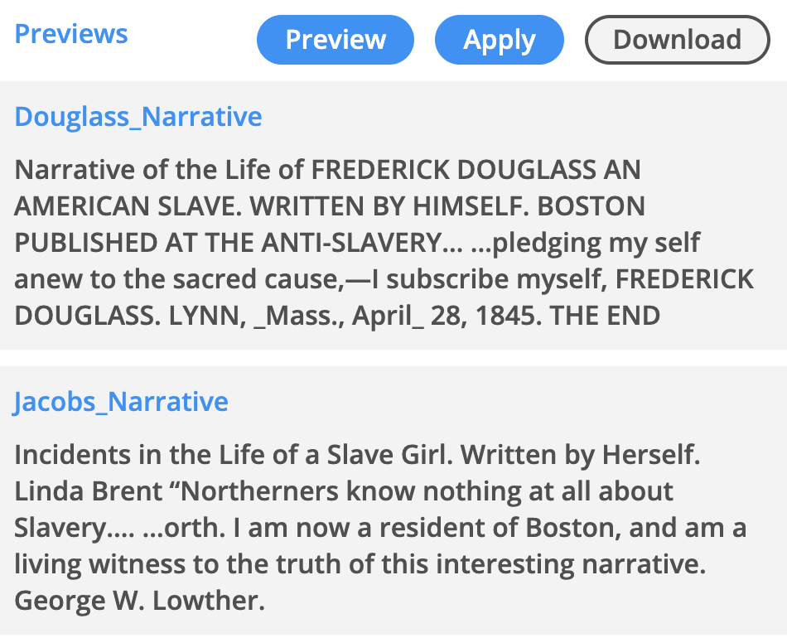
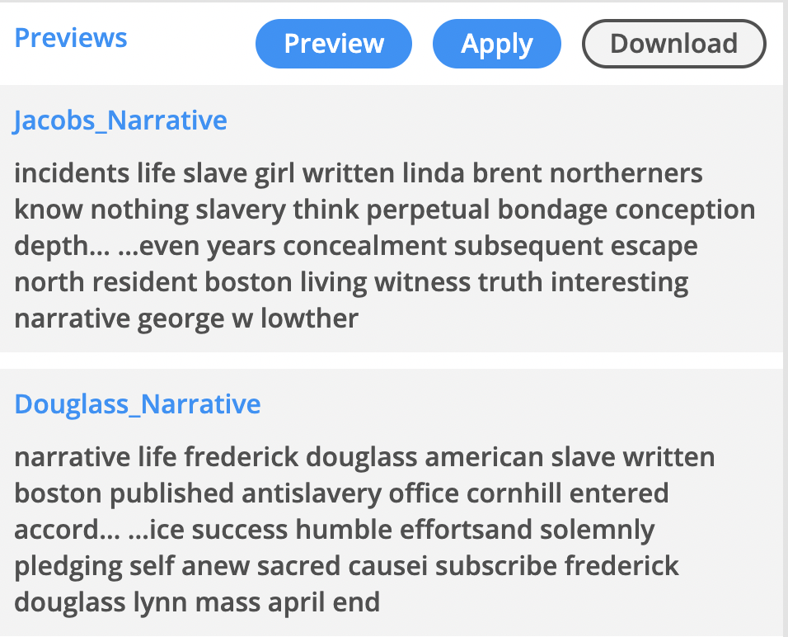
Lexos: Applying your Preparations
BEFORE PREP
AFTER PREP
Once you have made decisions about your preparations, click “Apply” and wait a few minutes. Because the program is going through each document and completing all the processes you selected, it needs some time. Then, you will see the final results of your preparation! You can also download your new corpus.
Notes:
Once you have made decisions about your preparations, click “Apply” and wait a few minutes.
Because the program is going through each document and completing all the processes you selected, it needs some time.
Then, you will see the final results of your preparation!
You can also download your new corpus.

Slide 39
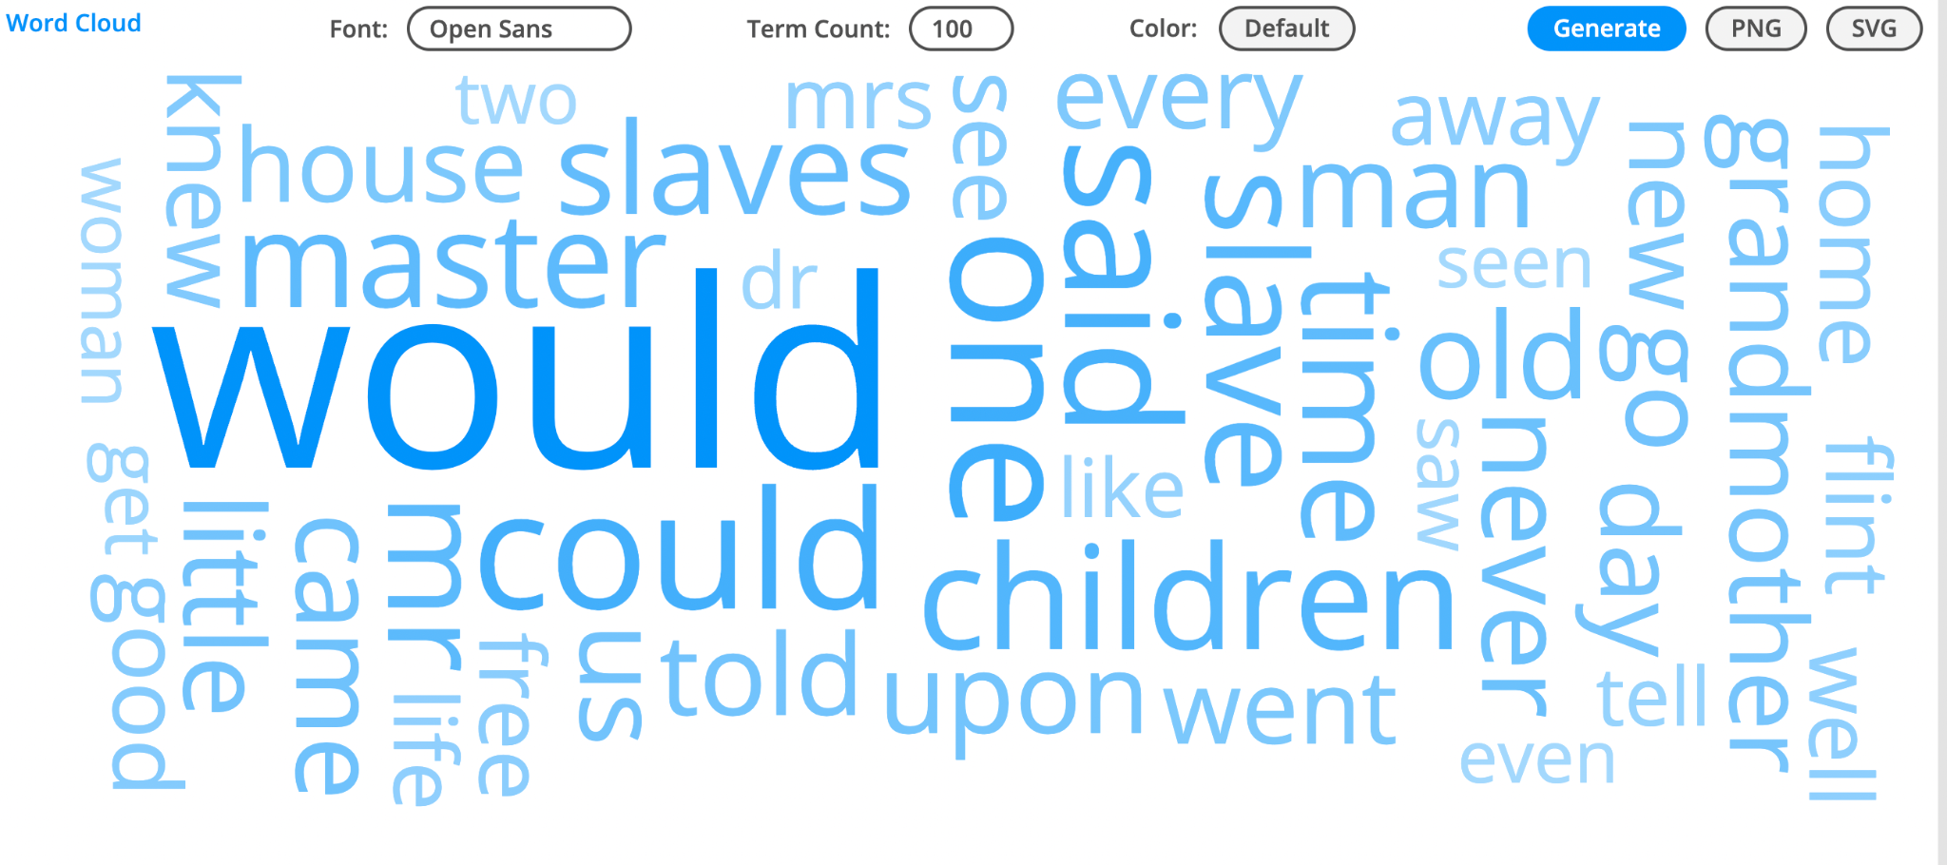
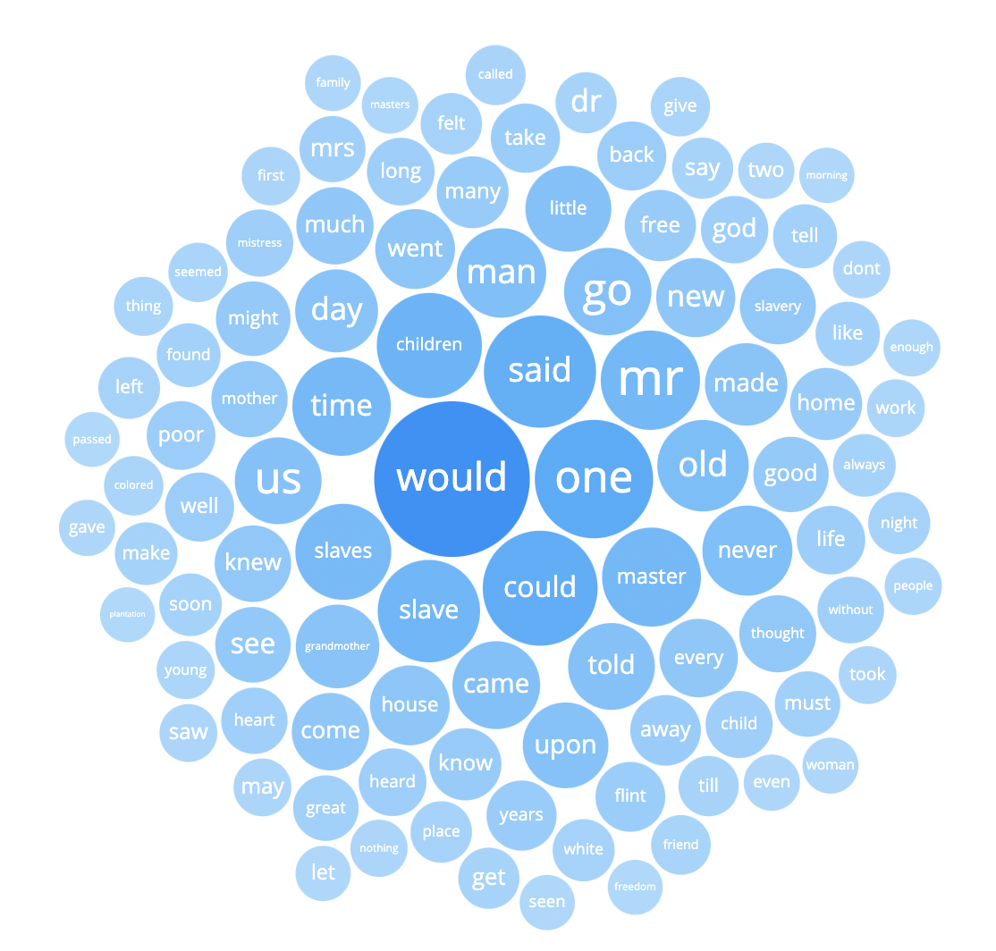
Lexos: Visualize
Bubbleviz: visualize word counts through bubbles across the entire text/corpus.
Word Cloud: visualize a wordcloud across the entire text/corpus.
Notes:
Notice how the word cloud suggests that much of the text s about conditions of possibility and potential for agency
Here are the Word Cloud and Bubbleviz results from Lexos.
This visualization is for the entire corpus [Explain - Show]

Slide 40
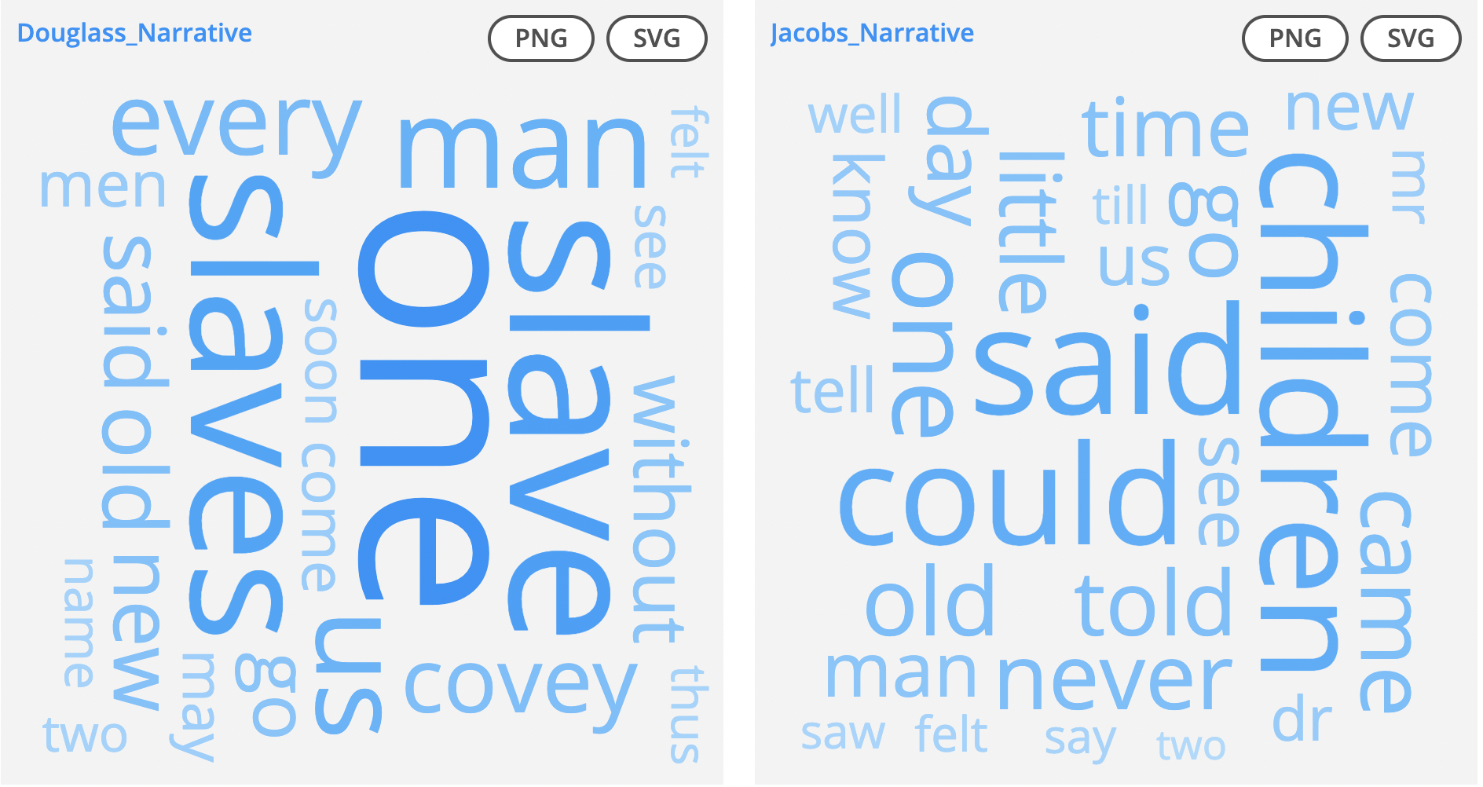
Lexos: Visualize > Multicloud
Notes:
This is a ‘Multicloud’ visualization which is showing word cloud for each of the two documents individually
This is a great option for comparing the documents [Explain]

Slide 41
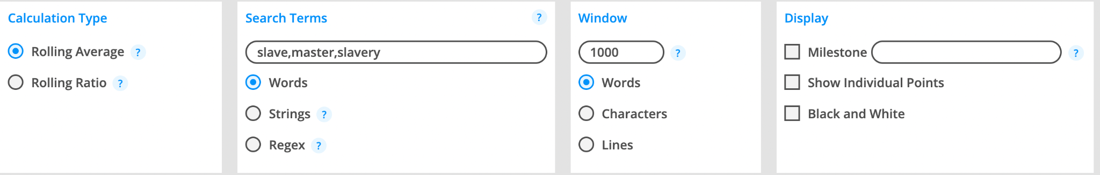
Lexos: Rolling Window
Rolling windows allow you to look at word trends across one document. To use a rolling window:
Go to “Visualize-> Rolling Window” and type in a search term you want to visualize. You can also search multiple terms by clicking “String” and separating words with a comma (heat, health, flood, storm)
Choose a Window size (the number of words each “window” contains). For shorter documents, it’s good to have a number like 300/500. For larger documents, you may want to make your window larger. Play around with the window size until you get a visualization that makes sense.
Click “Generate”
Notes:
Rolling window is a tool within Lexos that allows you to look at word trends across ‘one’ document.
This is a very helpful tool for analyzing a text in detail.
You can Go to “Visualize-> Rolling Window” and type in a search term you want to visualize.
You can also search multiple ‘Words’ or “Strings” by clicking the option and separating words with a comma
Choose a Window size (i.e. the number of words each “window” should contain). For shorter documents, it’s good to have a number like 300/500. For larger documents, you may want to make your window larger. Play around with the window size until you get a visualization that makes sense.
Once you have provided all the details, just ‘Generate’ the results.

Slide 42
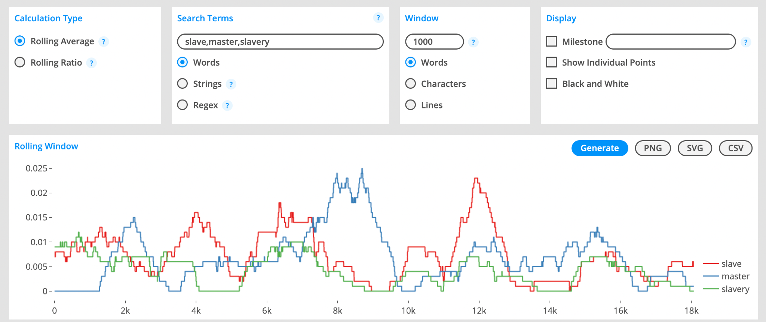
Lexos: Rolling Window Results
Using Narrative of the Life of Frederick Douglass, an American Slave and searching for the words ‘slave’, ‘master’ and ‘slavery’ with a window of 1000 words, we can get an idea of how these terms work together in the text.
Notes:
I looked for words ‘class’, ‘information’ and ‘property’ with a window of 200 (short document),
we can get an idea of how these terms work together in the report.

Slide 43
Lexos: Analyze > Dendrogram
The dendrogram demonstrates similarity between the different documents. Dendrograms require at least two documents to compare. Dendrograms are able to show the hierarchy between objects. Dendrograms show:
Similarities between texts
The greater the distance between texts, the less similar they are
The smaller the distance between texts, the more similar they are
Notes:
Dendrogram is another interesting tool, that you may or maynot choose to use
It requires at least two documents to compare.
Dendrograms are able to show the hierarchy between objects. It show:
Similarities between texts
The greater the distance between texts, the less similar they are
The smaller the distance between texts, the more similar they are

Slide 44
Lexos: Save or Reset Your Results
Lexos allows you to save your results as a Lexos file. If you do this, you can re-upload the Lexos file any time to access your cleaned-up corpus as well as the different analyses you’ve done. You can also download modified text files from the “Manage” page, which you can use with other tools if you would like.
You can also save individual visualizations as images (PNGs).
Finally, if you want to start over, you can “Reset” your Lexos dashboard.
Notes:
Lexos allows you to save your results as a Lexos file.
If you do this, you can re-upload the Lexos file any time to access your cleaned-up corpus as well as the different analyses you’ve done.
You can also download modified text files from the “Manage” page, which you can use with other tools if you would like.
You can also save individual visualizations as images (PNGs).
Finally, if you want to start over, you can “Reset” your Lexos dashboard.
-------
IF TIME PERMIT,
Now Julianna will show you the Voyant tool. [Given the limited time that we have, You may just look at the demonstration and explore the tool later using the handout document in GitHub folder.]

Slide 45
Your Turn!
Use the sample text or texts of your choice and begin practicing web-browser text analysis. Explore Lexos's features!
Discussion Prompts
What difference did you notice between Voyant and Lexos?
Which tool do you prefer and why?
How would you want to use these tools in this class and future?
Notes:
Use the sample text or texts of your choice and begin practicing web-browser text analysis. Explore Lexos's features!
Discussion Prompts
What difference did you notice between Voyant and Lexos?
Which tool do you prefer and why?
How would you want to use these tools in this class and future?

Slide 46
Thank you!
If you have any questions, contact us at nulab.info@gmail.com
Slides, handouts, and data available at:
https://bit.ly/3p6KEeU
You also have access to DITI Canvas Module on Computational Text Analysis.
Schedule an appointment with us! https://calendly.com/diti-nu
Notes:
We thank you for time and attention.
We hope you will use these tools and explore the possibility of text analysis in your assignments and projects.
Thank you Prof. Aldrich for this partnership
Take care and Good night

